Slide 1


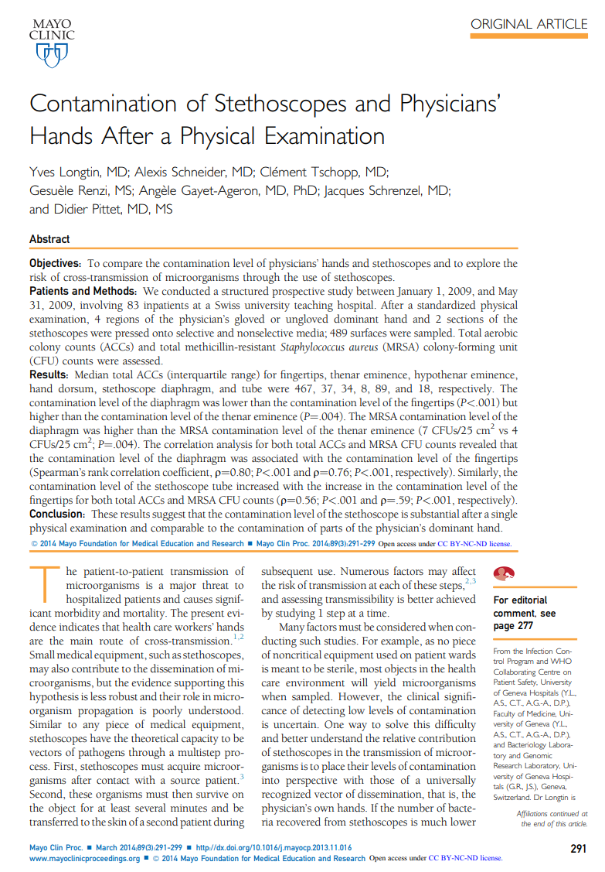

Selling With Evidence Contamination of Stethoscopes and Physicians’ Hands After a Physical Examination Longtin, et al.
“But what about the tubing??”

Slide 2
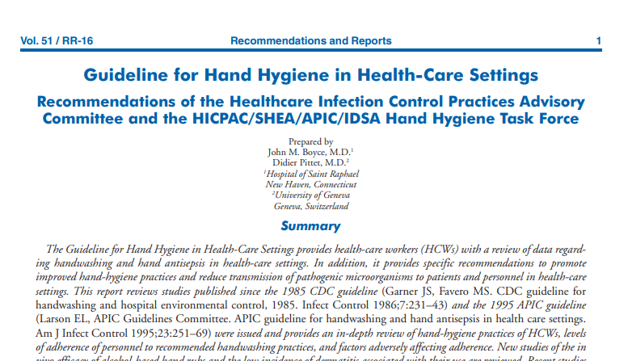
Author(s) of Note
Senior Author Didier Pittet, MD, MS
is an influential epidemiologist of the
CDC Healthcare Infection Control Practices Advisory Committee (HICPAC)
who co-authored the 2002 Guideline for Hand Hygiene in Health-Care Settings, which STANDARDIZED alcohol as a supplement to handwashing.
Efficacy

Slide 3
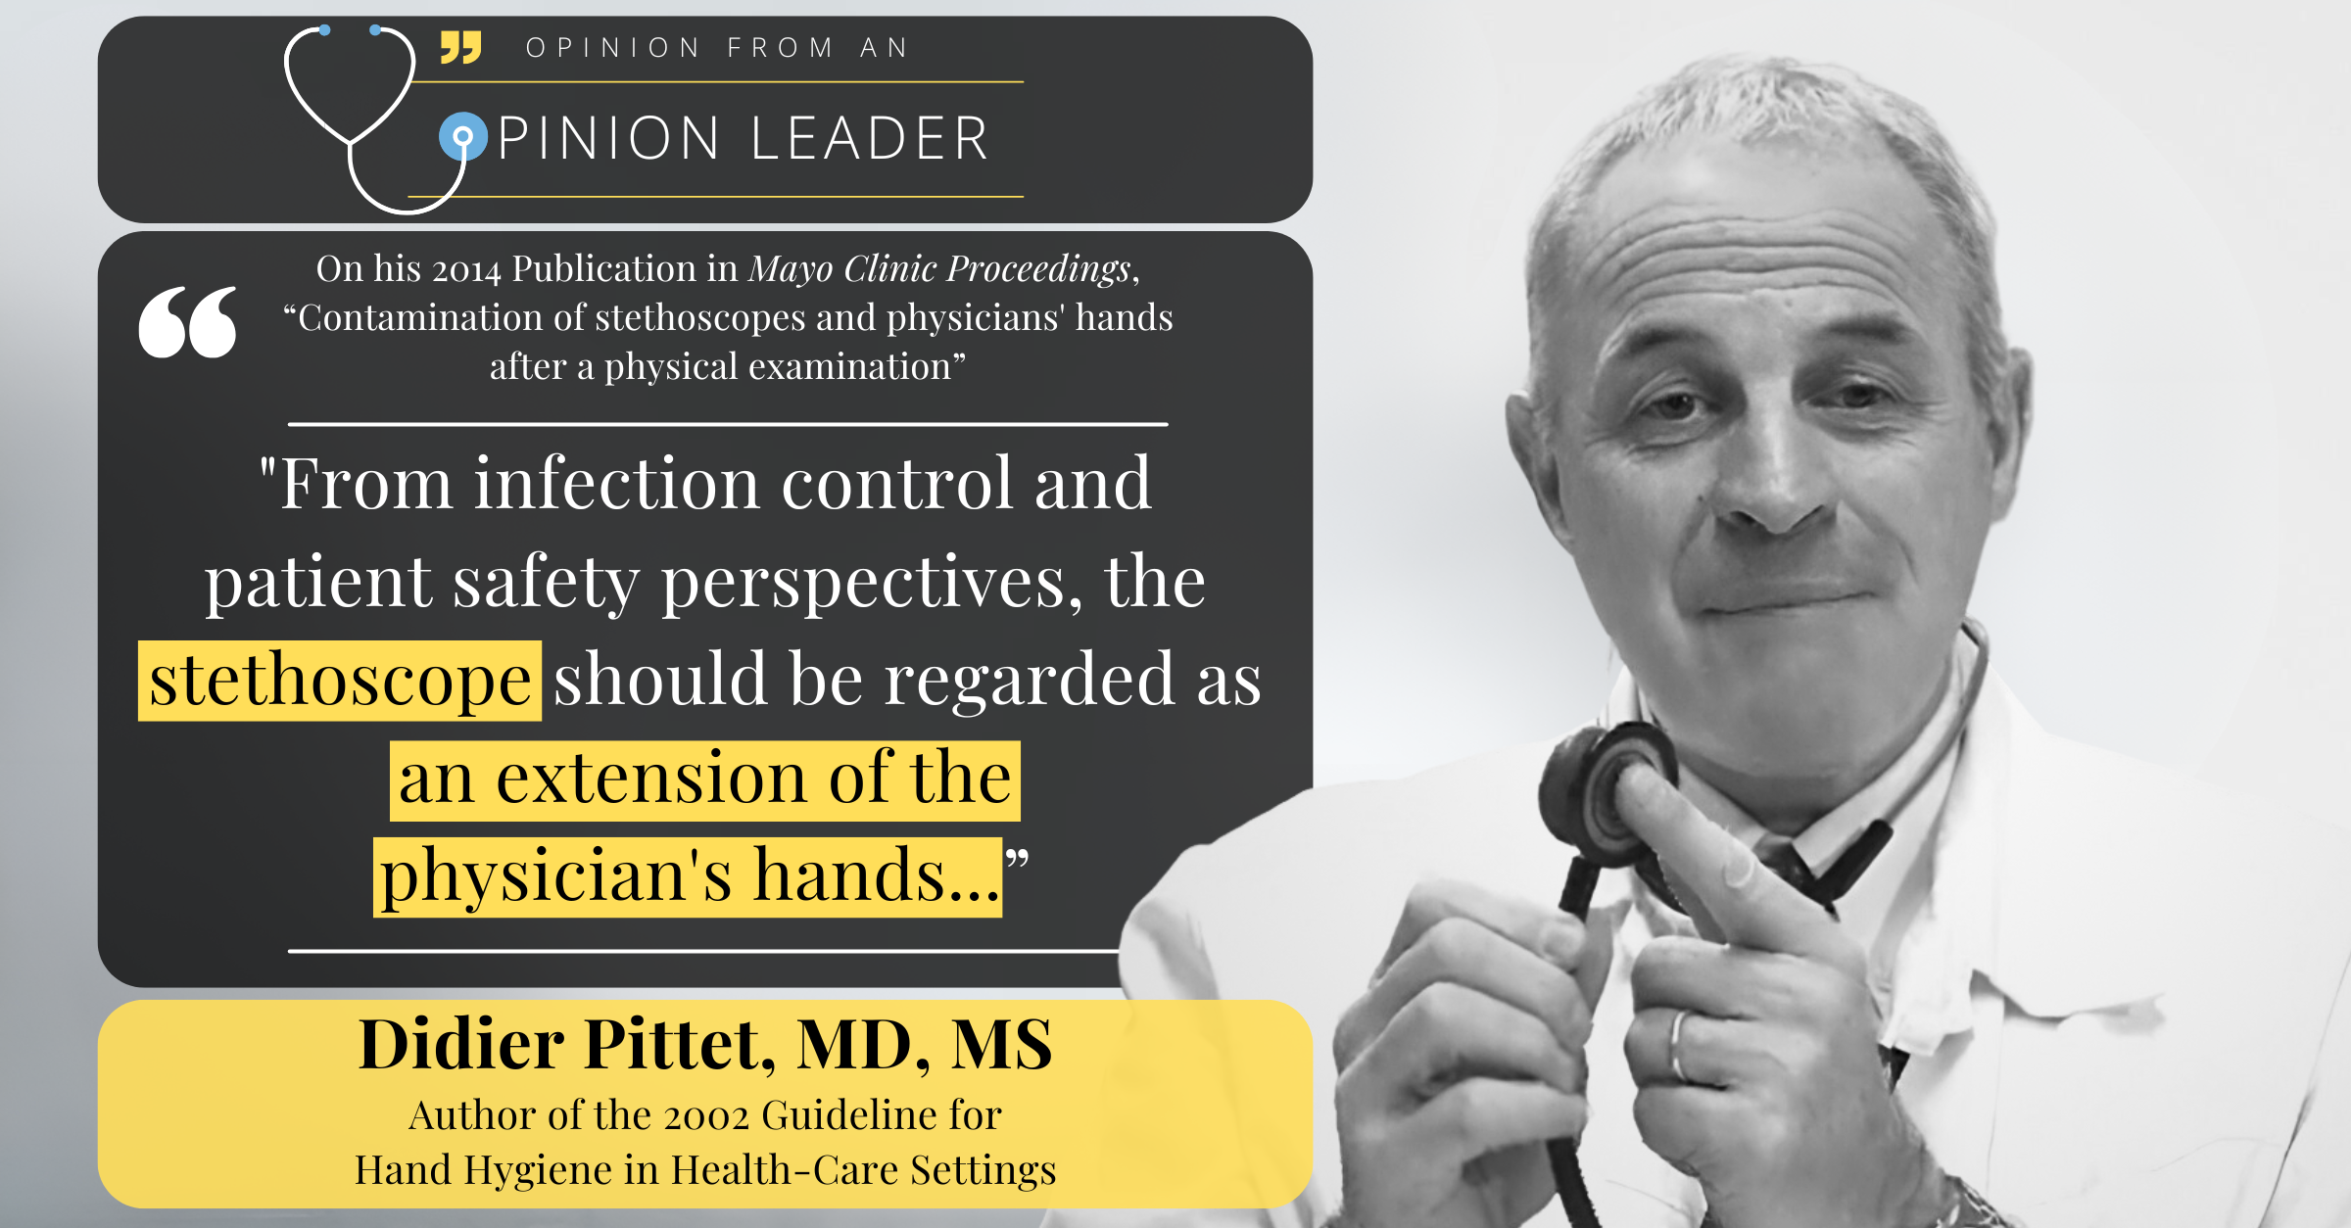

Slide 4
Methods
Cultured bacteria colonies from multiple clinician-to-patient touch points during an examination, including hands and stethoscopes.
Analyzed 4 regions of physician gloved & ungloved dominant hand, and 2 sections of the stethoscope.
Hand:
Fingertips
Thenar eminence
Hypothenar eminence
Dorsum
Stethoscope:
Diaphragm
Tube
Efficacy
Longtin Y. Contamination of Stethoscopes and Physicians’ Hands After a Physical Examination. Mayo Clin Proc. 2014;89(3):291-299

Slide 5


Results
Contamination After a Physical Examination
CFU/25cm²
CFU = Colony Forming Units
Key:
Total Aerobic CFUs
MRSA CFUs
467
12
467
467
12
12
467
489 Surfaces Sampled: Total Aerobic Colony Counts Measured
12
467
12
37
34
2
Dorsal Surface:
8/0 CFU/25cm²
4
Longtin Y. Contamination of Stethoscopes and Physicians’ Hands After a Physical Examination. Mayo Clin Proc. 2014;89(3):291-299

Slide 6


Results
Contamination After a Physical Examination
467
Key:
Total Aerobic CFUs
MRSA CFUs
12
467
467
12
12
467
87
12
7
18
0
467
12
37
34
2
Dorsal Surface:
8/0 CFU/25cm²
4
CFU/25cm²
Longtin Y. Contamination of Stethoscopes and Physicians’ Hands After a Physical Examination. Mayo Clin Proc. 2014;89(3):291-299

Slide 7
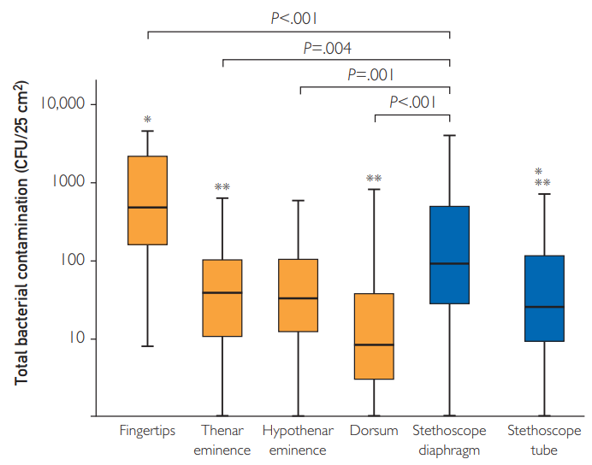
Key Points
The contamination of the stethoscope diaphragm was comparable to the clinician’s fingertips following a physical examination.
The stethoscope diaphragm was the 2nd most contaminated surface after the clinician’s fingertips for both total aerobic and MRSA CFUs.
Efficacy
Longtin Y. Contamination of Stethoscopes and Physicians’ Hands After a Physical Examination. Mayo Clin Proc. 2014;89(3):291-299

Slide 8
Key Points
The contamination of the stethoscope diaphragm was comparable to the clinician’s fingertips following a physical examination.
The stethoscope diaphragm was the 2nd most contaminated surface after the clinician’s fingertips for both total aerobic and MRSA CFUs.
Efficacy
Longtin Y. Contamination of Stethoscopes and Physicians’ Hands After a Physical Examination. Mayo Clin Proc. 2014;89(3):291-299

Slide 9
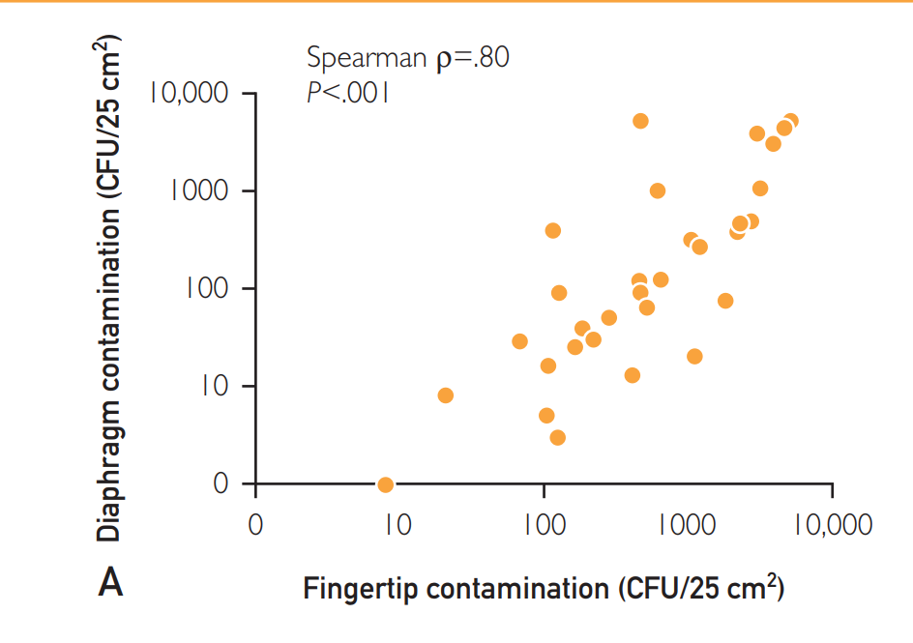
Key Points
The contamination level of stethoscopes was strongly associated with the contamination level of physicians’ hands.
i.e., higher contamination of hands were correlated with higher contamination of stethoscopes.
Efficacy
Longtin Y. Contamination of Stethoscopes and Physicians’ Hands After a Physical Examination. Mayo Clin Proc. 2014;89(3):291-299

Slide 10
Key Points
The contamination level of stethoscopes was strongly associated with the contamination level of physicians’ hands.
i.e., higher contamination of hands were correlated with higher contamination of stethoscopes.
Efficacy
Longtin Y. Contamination of Stethoscopes and Physicians’ Hands After a Physical Examination. Mayo Clin Proc. 2014;89(3):291-299

Slide 11
Key Points
The contamination level of stethoscopes was strongly associated with the contamination level of physicians’ hands.
i.e., higher contamination of hands were correlated with higher contamination of stethoscopes.
Efficacy
Longtin Y. Contamination of Stethoscopes and Physicians’ Hands After a Physical Examination. Mayo Clin Proc. 2014;89(3):291-299

Slide 12
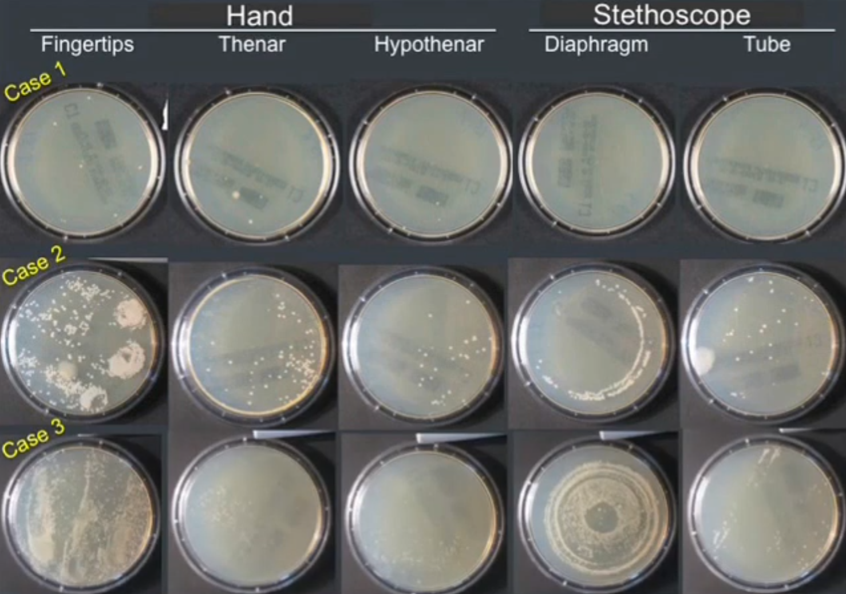
Key Points
The contamination level of stethoscopes was strongly associated with the contamination level of physicians’ hands.
i.e., higher contamination of hands were correlated with higher contamination of stethoscopes.
Efficacy
Longtin Y. Contamination of Stethoscopes and Physicians’ Hands After a Physical Examination. Mayo Clin Proc. 2014;89(3):291-299

Slide 13
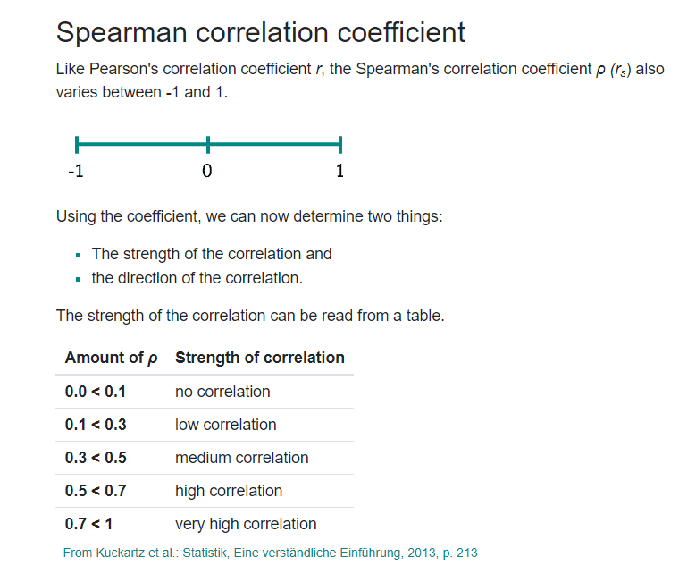
The contamination level of stethoscopes was strongly associated with the contamination level of physicians’ hands.
i.e., higher contamination of hands were correlated with higher contamination of stethoscopes.
Efficacy
Longtin Y. Contamination of Stethoscopes and Physicians’ Hands After a Physical Examination. Mayo Clin Proc. 2014;89(3):291-299

Slide 14

Conclusion
“These results suggest that the
contamination level of the stethoscope is substantial
after a single physical examination and comparable to the contamination of parts of the physician’s dominant hand.”
Efficacy
Longtin Y. Contamination of Stethoscopes and Physicians’ Hands After a Physical Examination. Mayo Clin Proc. 2014;89(3):291-299

Slide 15
3 Bullets to Remember
2nd Highest Contaminated Surface is the Stethoscope Diaphragm
High Correlation with Fingertip<>Diaphragm Contamination
Tubing Contamination Low, so transmission risk is low.
Efficacy
Longtin Y. Contamination of Stethoscopes and Physicians’ Hands After a Physical Examination. Mayo Clin Proc. 2014;89(3):291-299

